Slide 1



Cryptography
Notes:
6. **Introduction to Cryptographic Techniques (30 mins)**
- Introduction to this area. This would give an overview of what happens in the entire encryption/decryption process. We will mention public and private cryptography.
- Topics:
- Cryptographic Techniques
- Public and Private Cryptography
7. **Encryption (30 mins)**
- Explain how we perform encryption and different forms of encryption.
- Topics:
- Symmetric Encryption
- Asymmetric Encryption
- Hashing
8. **Decryption (30 mins)**
- Explain how we perform decryption and then discuss issues regarding different cryptographic techniques.
- Topics:
- Symmetric Decryption
- Asymmetric Decryption
- Cryptographic Issues

Slide 2
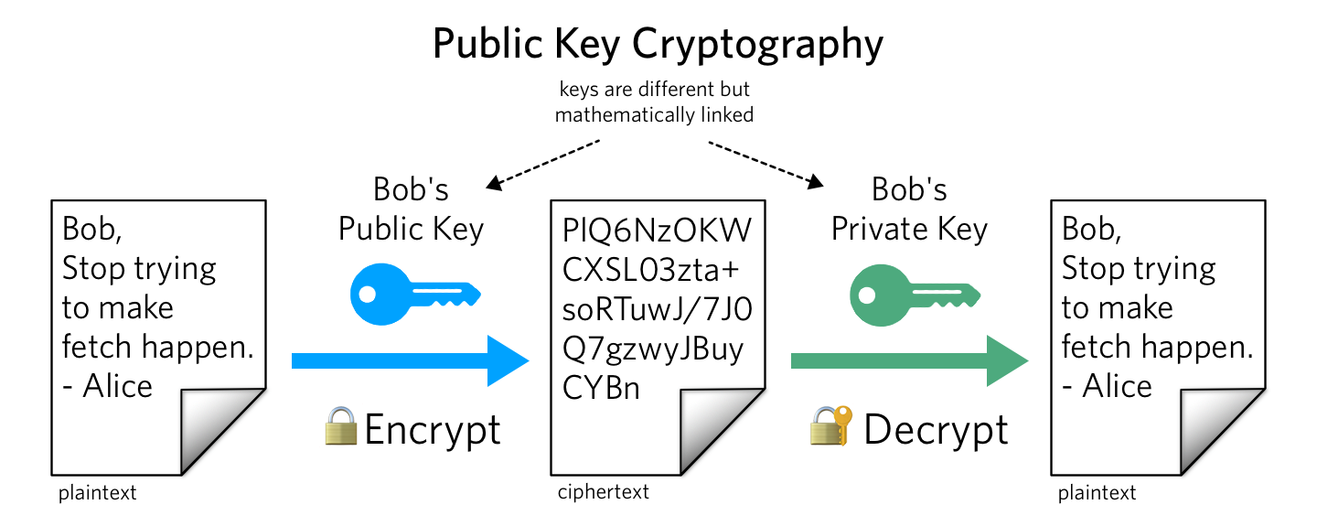
https://www.twilio.com/en-us/blog/what-is-public-key-cryptography

Slide 3
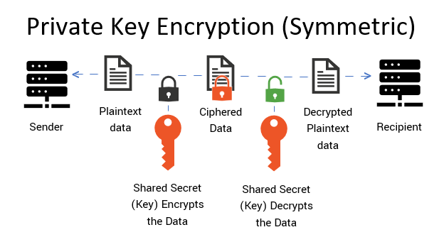
https://cheapsslsecurity.com/p/what-is-public-key-and-private-key-cryptography-and-how-does-it-work/

Slide 4
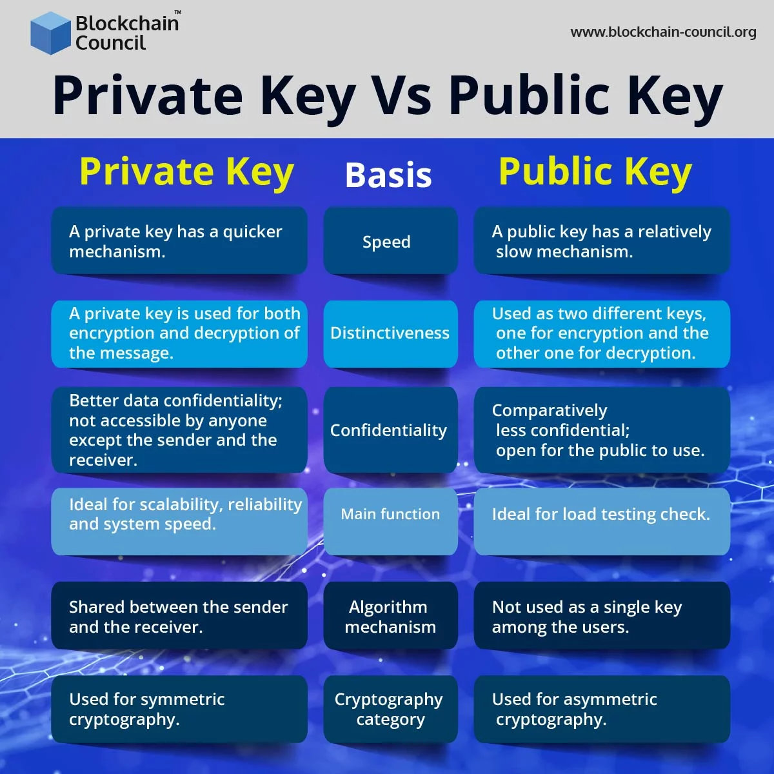
https://www.blockchain-council.org/blockchain/private-key-vs-public-key/

Slide 5
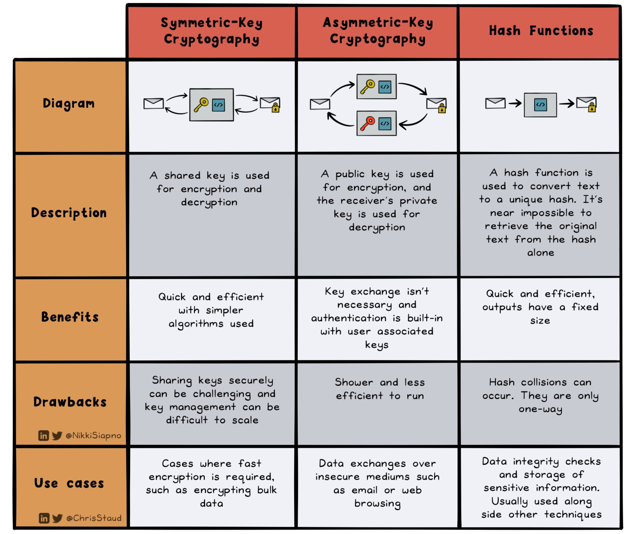
https://twitter.com/ChrisStaud/status/1667132937677197312

Slide 6
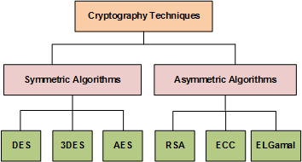
https://www.researchgate.net/figure/Taxonomy-of-cryptography-techniques_fig4_318200344

Slide 7
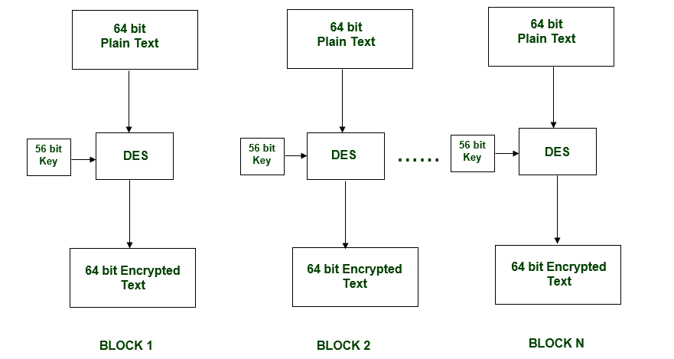
https://www.geeksforgeeks.org/des-full-form/

Slide 8
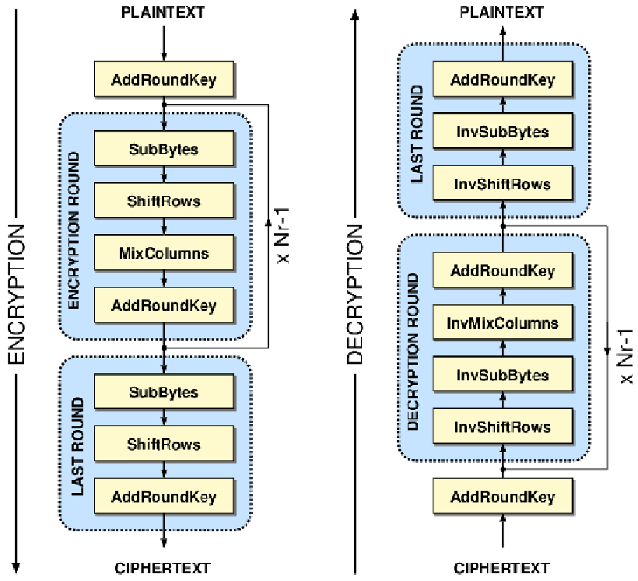
https://www.researchgate.net/figure/The-basic-AES-128-cryptographic-architecture_fig1_230853805

